Slide 1
HOSPITAL DATABASE

Slide 2

Agenda: 01-ERD 02-Relational schema 03-Tables Creation 04-Insertion Queries 05-SQL Optimization 06-GUI

Slide 3
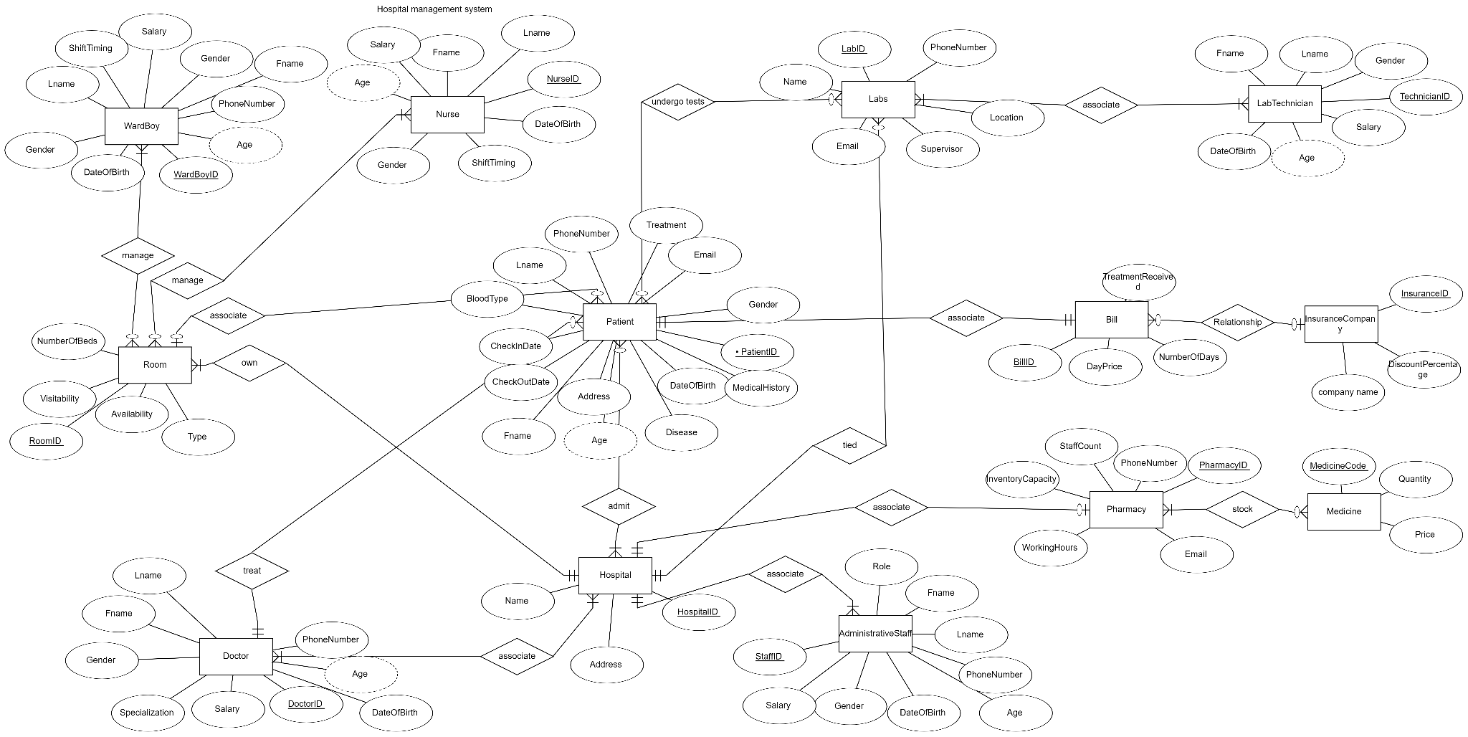
Entity Relational Diagram (ERD)

Slide 4
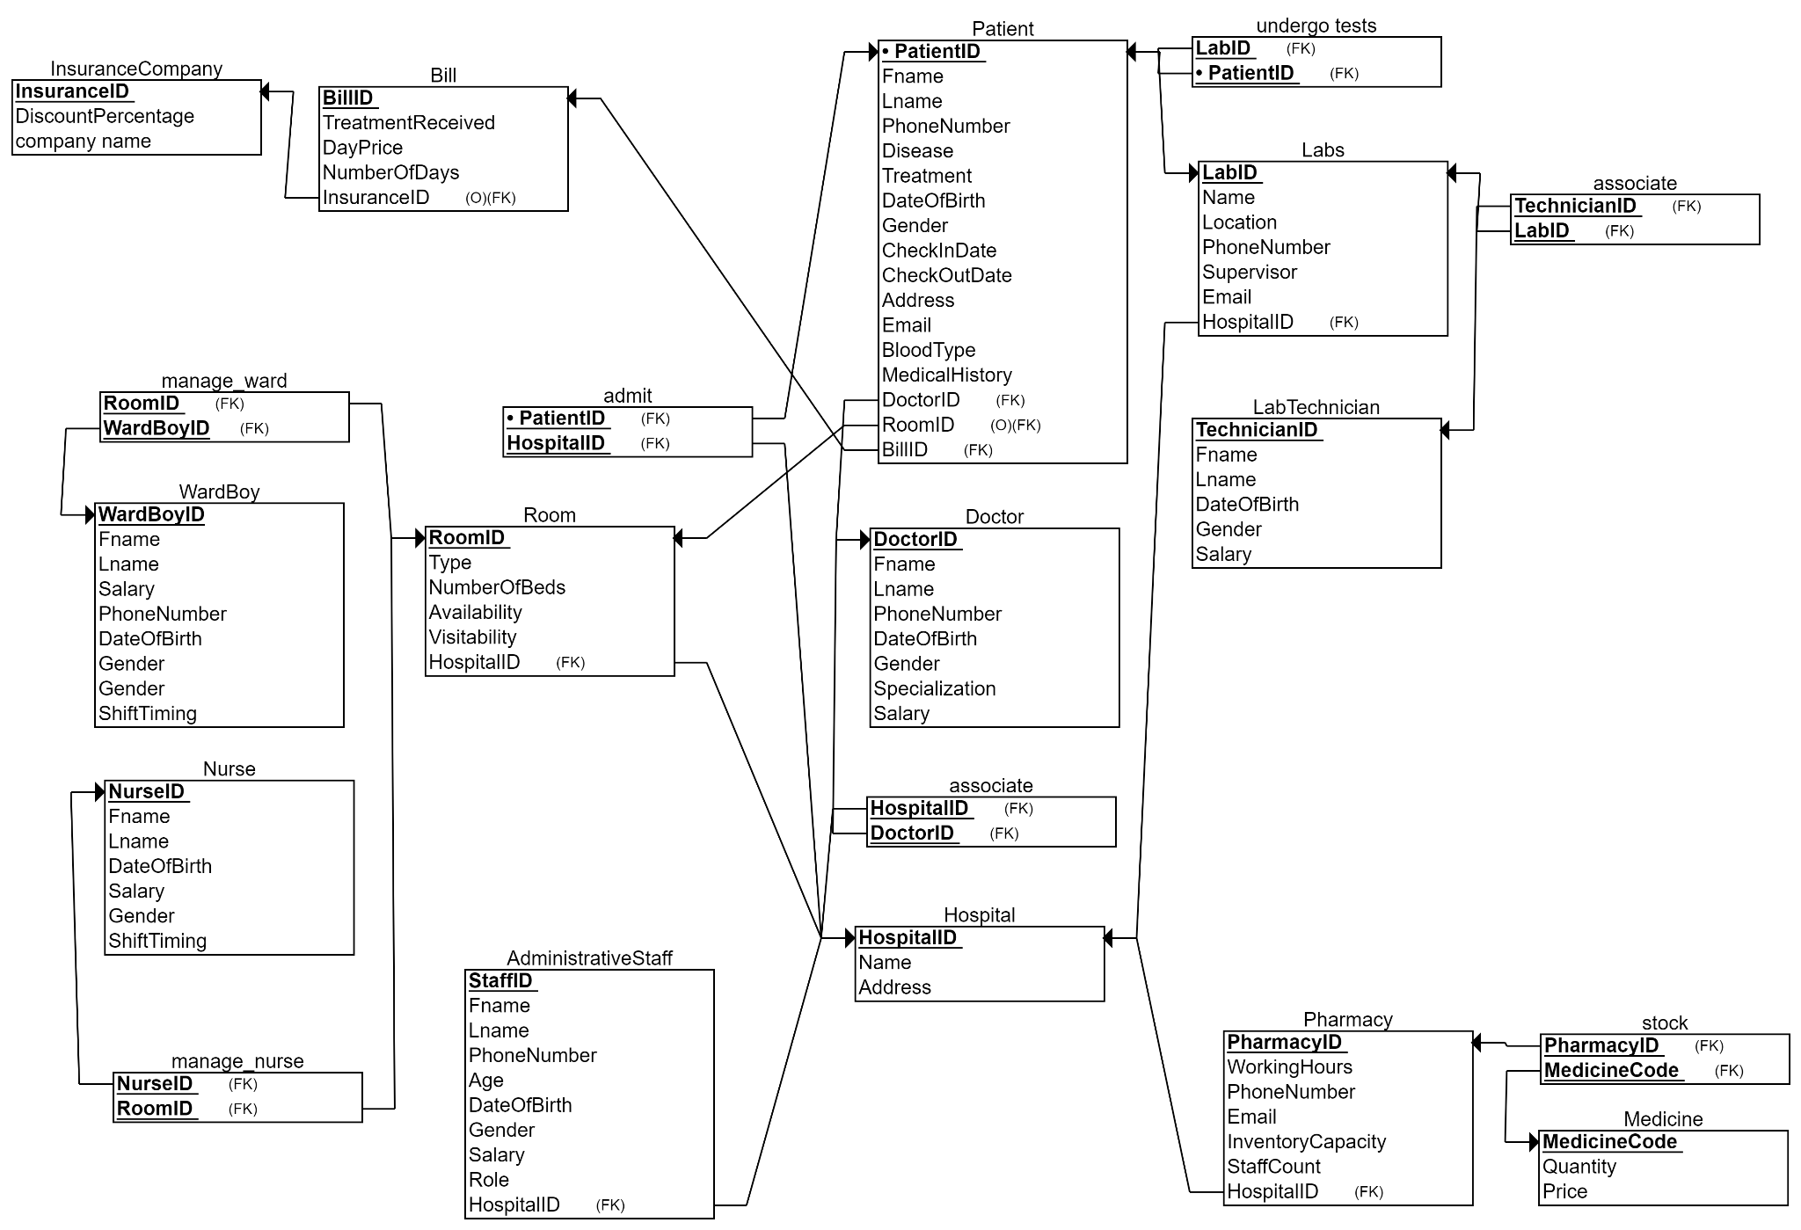
Relational Schema

Slide 5
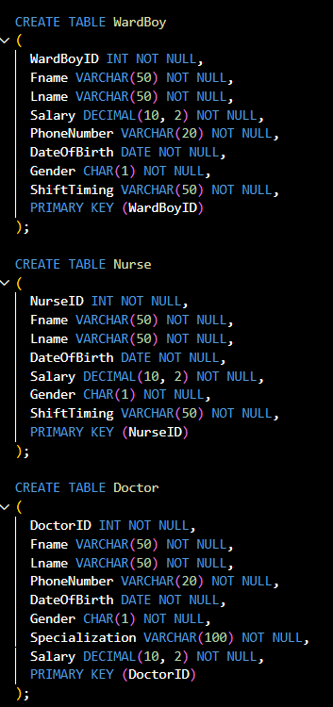
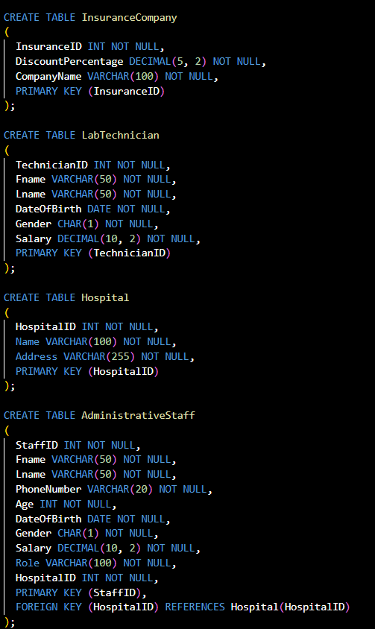
Tables Creation queries
Here’s example,
the entire tables in the sql file in the zip file

Slide 6
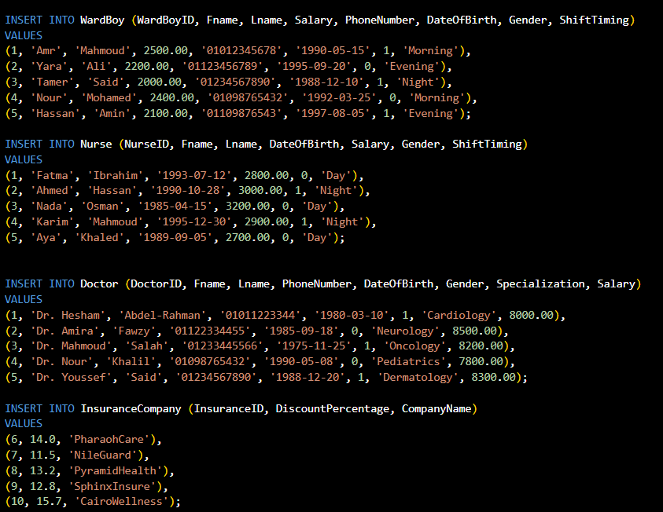
Insertion queries
Here’s example,
the entire tables in the sql file in the zip file

Slide 7
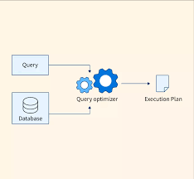
Optimizing SQL Queries:
Reduced query execution time
Improved scalability
Lower hardware resource consumption
More efficient use of storage space

Slide 8
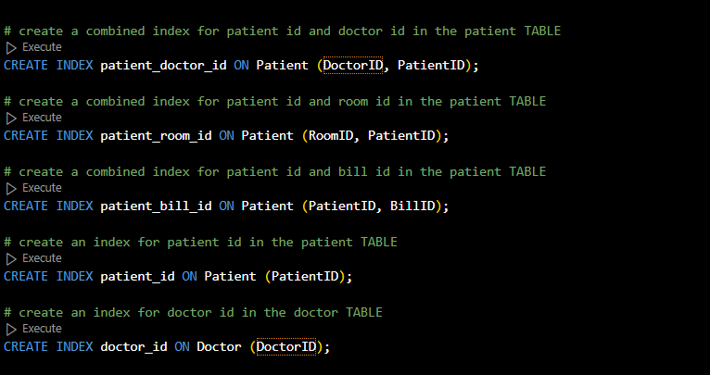
When to use indexes:
Columns that are frequently used in WHERE clauses and JOINs
Columns that are used to sort or group data
Columns that have high selectivity (meaning that a small number of distinct values exist)

Slide 9
Single Column Indexing
index for patient id in the patient TABLE
index for doctor id in the doctor TABLE

Slide 10
Composite indexing (1)
combined index for patient id and doctor id in the patient TABLE
Column Order
A column which is having the least cardinality value (Having less number of distinctive values) should always be positioned as the left-most side in a composite index.
In the example, the cardinality of DoctorID is less than PatientID

Slide 11
Composite indexing (2)
combined index for patient id and room id in the patient TABLE
Column Order
A column which is having the least cardinality value (Having less number of distinctive values) should always be positioned as the left-most side in a composite index.
In the example, the cardinality of RoomID is less than PatientID

Slide 12
Composite indexing (3)
combined index for patient id and bill id in the patient TABLE
Column Order
A column which is having the least cardinality value (Having less number of distinctive values) should always be positioned as the left-most side in a composite index.
In the example, the cardinality of PatientID is less than BillID (doesn’t matter here)

Slide 13
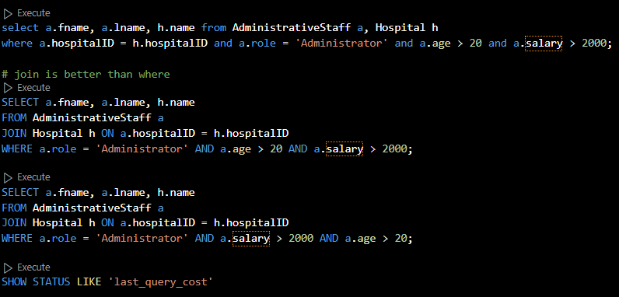
Want to find best plan.
USE JOIN BETTER THAN WHERE CLAUSE
Put the most selective conditions first

Slide 14
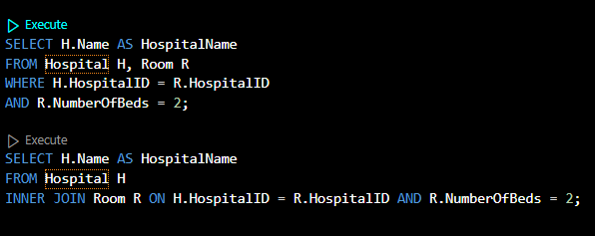
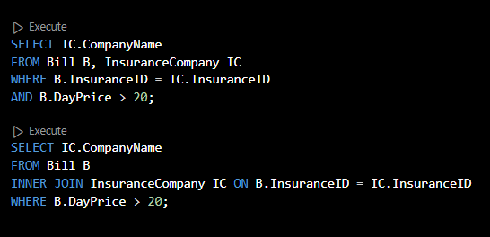
For best plan:
So Instead of we do this
Instead of
we do this

Slide 15
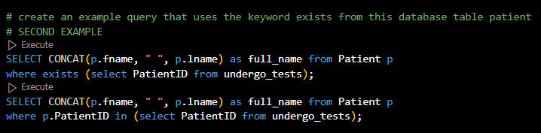
EXISTS VS. IN condition
Exists: To Avoids repeating joins or complex comparisons.

Slide 16
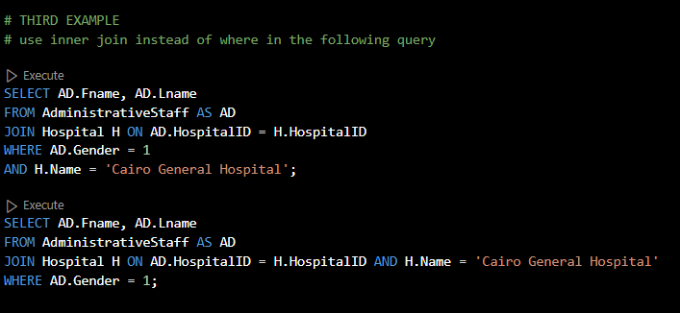
inner join instead of where
Reduced data processing
The join only select from tables based on the condition
minimizing the number of rows needing further filtering.

Slide 17
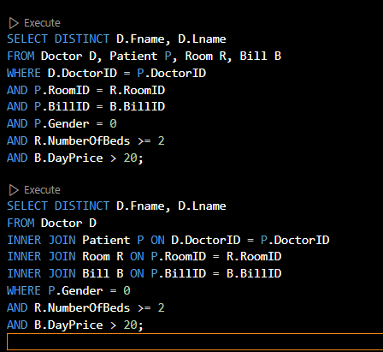
For best plan:
So Instead of
we do this

Slide 18
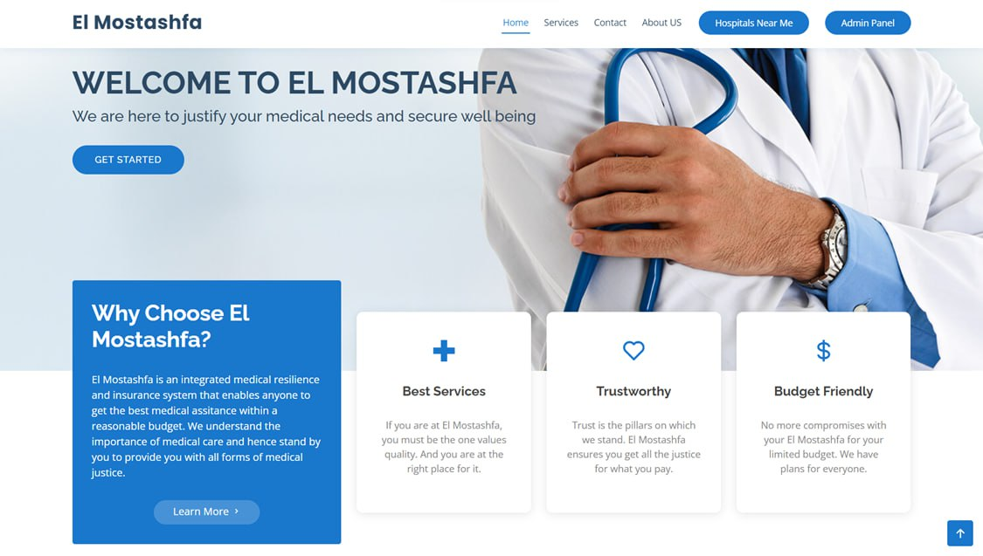
GUI
HOME PAGE :

Slide 19
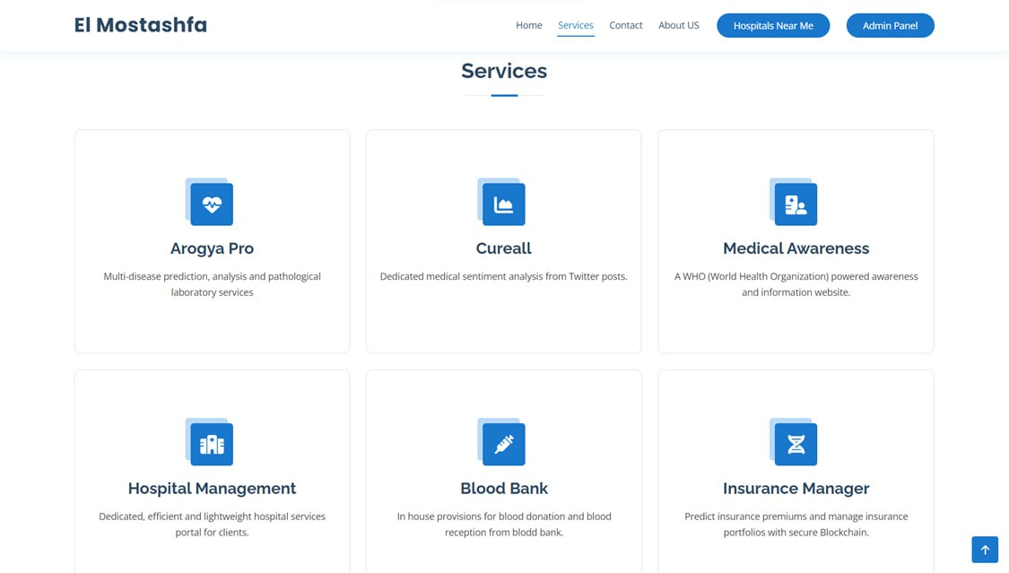
GUI
SERVICES PAGE:

Slide 20

GUI
GALLERY PAGE:

Slide 21
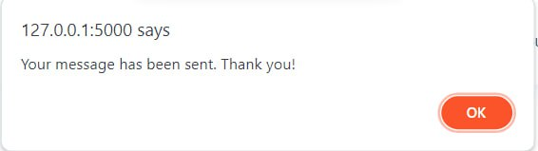
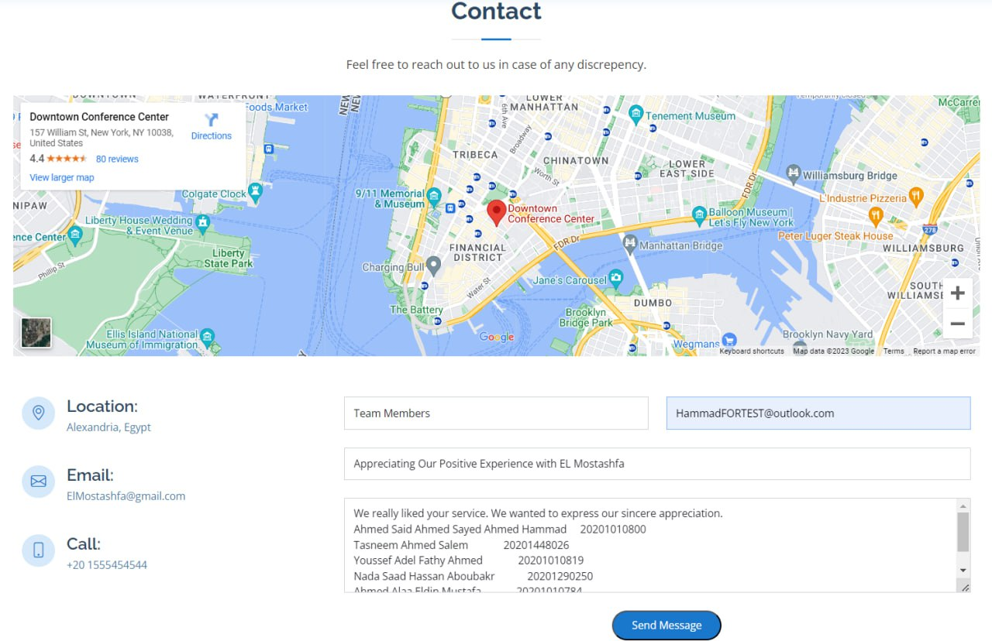
GUI
CONTACT US PAGE:

Slide 22
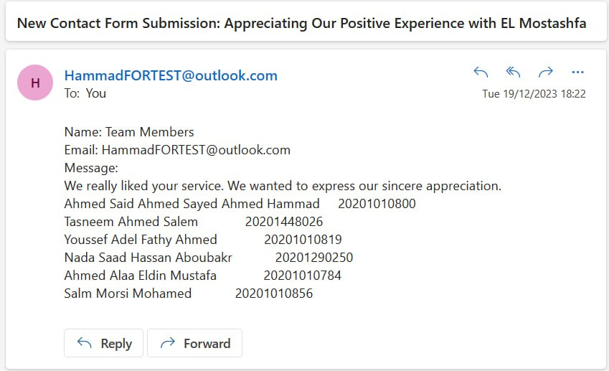
GUI
We will receive mail

Slide 23
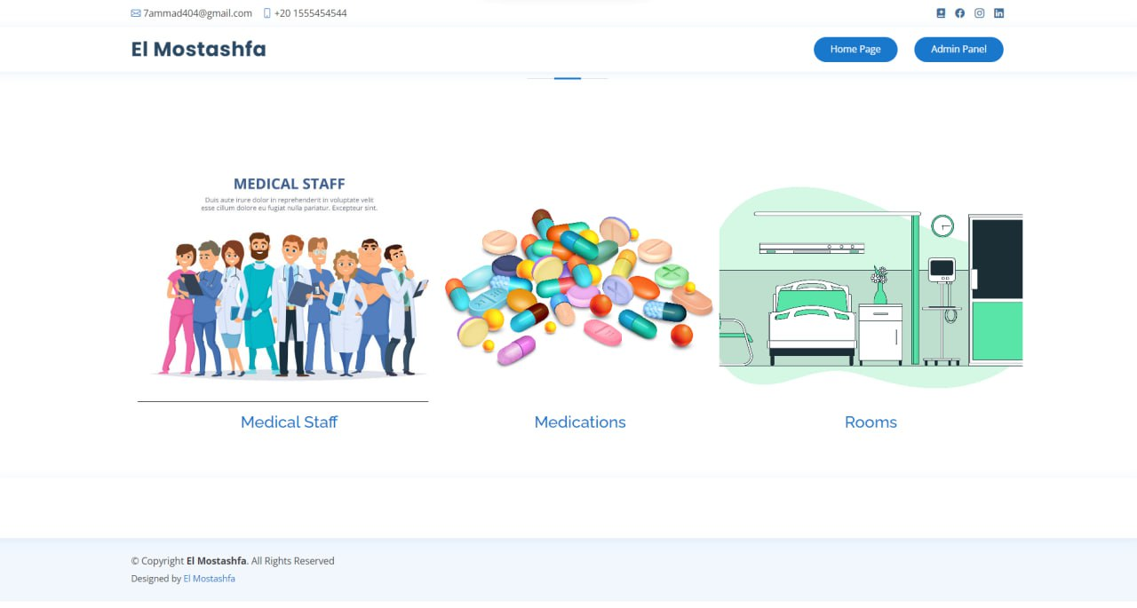
GUI
ADMIN PAGE:

Slide 24
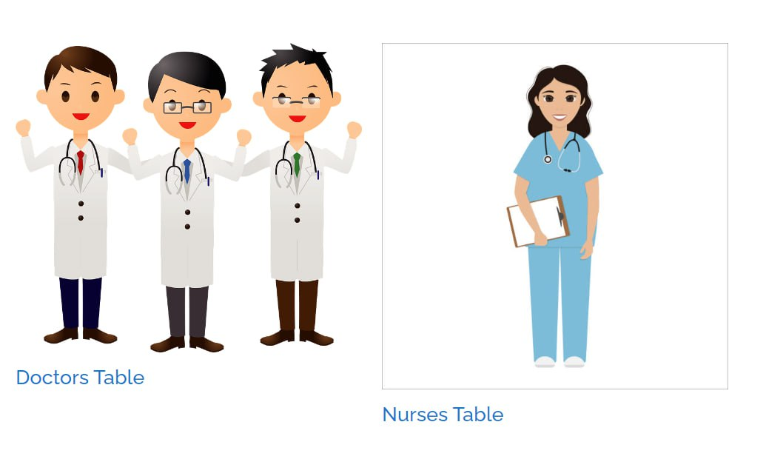
GUI
ADMIN PAGE (CONT’D):

Slide 25
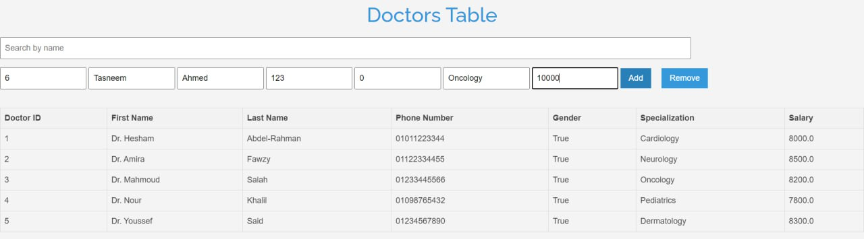
GUI
TO ADD A DOCTOR :

Slide 26
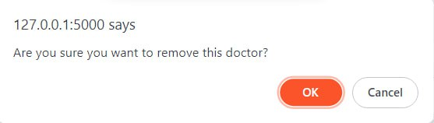
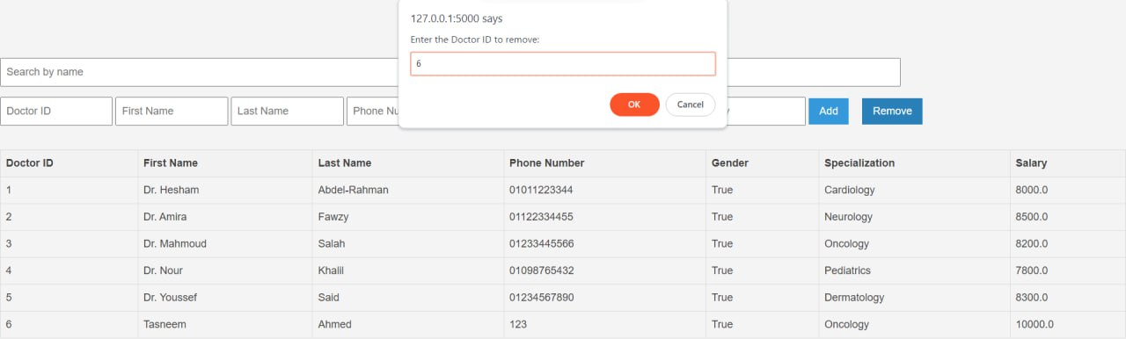
GUI
TO REMOVE A DOCTOR :

Slide 27
THANK YOU ♥

